Slide 1
HeartWatch: AFib Monitoring
CONTINUE
Brian Ngo, Ammar Khakoo, Desmond Patrick Bolia, Yuxuan Lu

Slide 2
1
What is AFiB?
PREV
NEXT

Slide 3
INTRODUCTION
PREV
NEXT
AFib: irregular, rapid heart rhythm; risks include stroke and heart failure
Effective management depends on strict medication adherence
Elderly patients face adherence challenges due to multiple factors
Non-adherence impacts healthcare outcomes and increases costs
Rising AFib prevalence and aging population make adherence crucial

Slide 4
Understanding Atrial Fibrillation
PREV
NEXT
Potential Complications of AFib
Can lead to serious complications such as stroke, heart failure, and other heart-related complications.
Definition and Characteristics of AFib
Can lead to the formation of blood clots in the heart, increasing the risk of stroke and other complications.

Slide 5
Challenges of Medication Adherence in AFib Patients
PREV
NEXT
Impact of Non-Adherence on Healthcare Outcomes and Costs
Non-adherence to medication regimens in AFib patients accounts for 125,000 deaths annually in the U.S. Non-adherence also adds approximately $300 billion to healthcare costs.
Factors Contributing to Non-Adherence
Forgetfulness, confusion over complex dosing schedules, and difficulty maintaining regular monitoring routines contribute to non-adherence in AFib patients. The elderly population, in particular, faces challenges in adhering to strict medication regimens.
Benjamin RM. Medication adherence: helping patients take their medicines as directed. Public Health Rep. 2012 Jan-Feb;127(1):2-3. doi: 10.1177/003335491212700102. PMID: 22298918; PMCID: PMC3234383.

Slide 6
Growing Importance of Addressing Medication Adherence in AFib
Statistics on Medication Use in Older Populations
Aging Population and Increasing Prevalence of AFib
Around 86.3% of American adults aged 60-79 take at least one prescription medication. This highlights the scale of the adherence problem in older populations.
The global population aged 60 and older is expected to double to 2.1 billion by 2050. AFib primarily affects older adults, making it a growing concern with the aging population.
Jin H, Kim Y, Rhie SJ. Factors affecting medication adherence in elderly people. Patient Prefer Adherence. 2016 Oct 19;10:2117-2125. doi: 10.2147/PPA.S118121. PMID: 27799748; PMCID: PMC5077271.

Slide 7
The Need for Innovative Solutions
The Role of Innovative Approaches in Supporting AFib Patients
Innovative solutions are needed to support AFib patients in reliably managing their symptoms and adhering to prescribed treatments. These solutions can help address the challenges of forgetfulness, complex dosing schedules, and regular monitoring routines.
Importance of Reliable Symptom Management and Treatment Adherence
Reliable symptom management and treatment adherence are crucial in managing AFib and preventing complications. Adherence to medication regimens is essential for preventing blood clots and managing the risk of stroke.

Slide 8
2
Proposal Statement
PREV
NEXT

Slide 9
Our Solution
To address the challenges faced by elderly individuals with AFib, we propose the development of a software application designed specifically for AFib symptom monitoring and prescription adherence called Heartwatch

Slide 10
Challenges Faced by Elderly Individuals with AFib
Adherence to medication and treatment plans
Monitoring and managing symptoms effectively
Maintaining a healthy lifestyle and reducing risk factors
Seeking timely medical attention for abnormal vitals or symptoms

Slide 11
Overview of HeartWatch
Utilization of IoT Technology and AI-Driven Analytics
Leveraging IoT technology to collect and analyze data from wearable devices AI-driven analytics to provide actionable insights and personalized feedback Empowers users to take a proactive approach to their AFib management
Compatibility with Popular Wearable Devices
Compatible with popular wearable devices like Apple Watch, Fitbit, and Garmin Seamless integration with existing technology for convenient and continuous monitoring Allows users to track their vital signs and symptoms in real-time

Slide 12
Key Features of the Application
Real-Time Alerts and Reminders
Motion Sensor Data Analysis
Vital Sign Monitoring
Sends real-time alerts and reminders for medication intake and doctor's appointments
Customizable alerts based on individual preferences and needs
Prompts users to seek medical attention for abnormal vitals or symptoms
Tracks blood pressure, heart rate, and blood oxygen levels
Provides real-time updates and historical data for monitoring trends
Alerts users to abnormal vitals that may require medical attention
Analyzes motion sensor data to confirm medication intake patterns
Ensures adherence to prescription schedules and dosage instructions
Provides reminders and alerts for medication intake

Slide 13
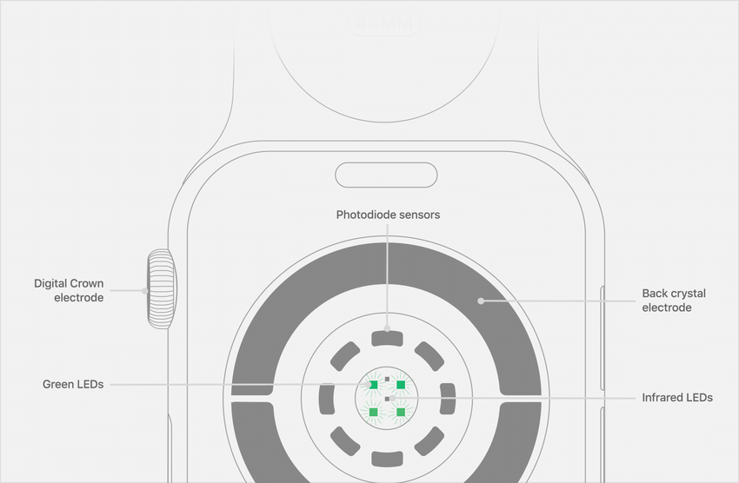
Leverage Existing Technology
PPG (Photoplethysmography) Sensors
A non-invasive sensor existing in nearly all modern smartwatches.
Uses a lightsource and a photodetector to measure blood volume variations

Slide 14
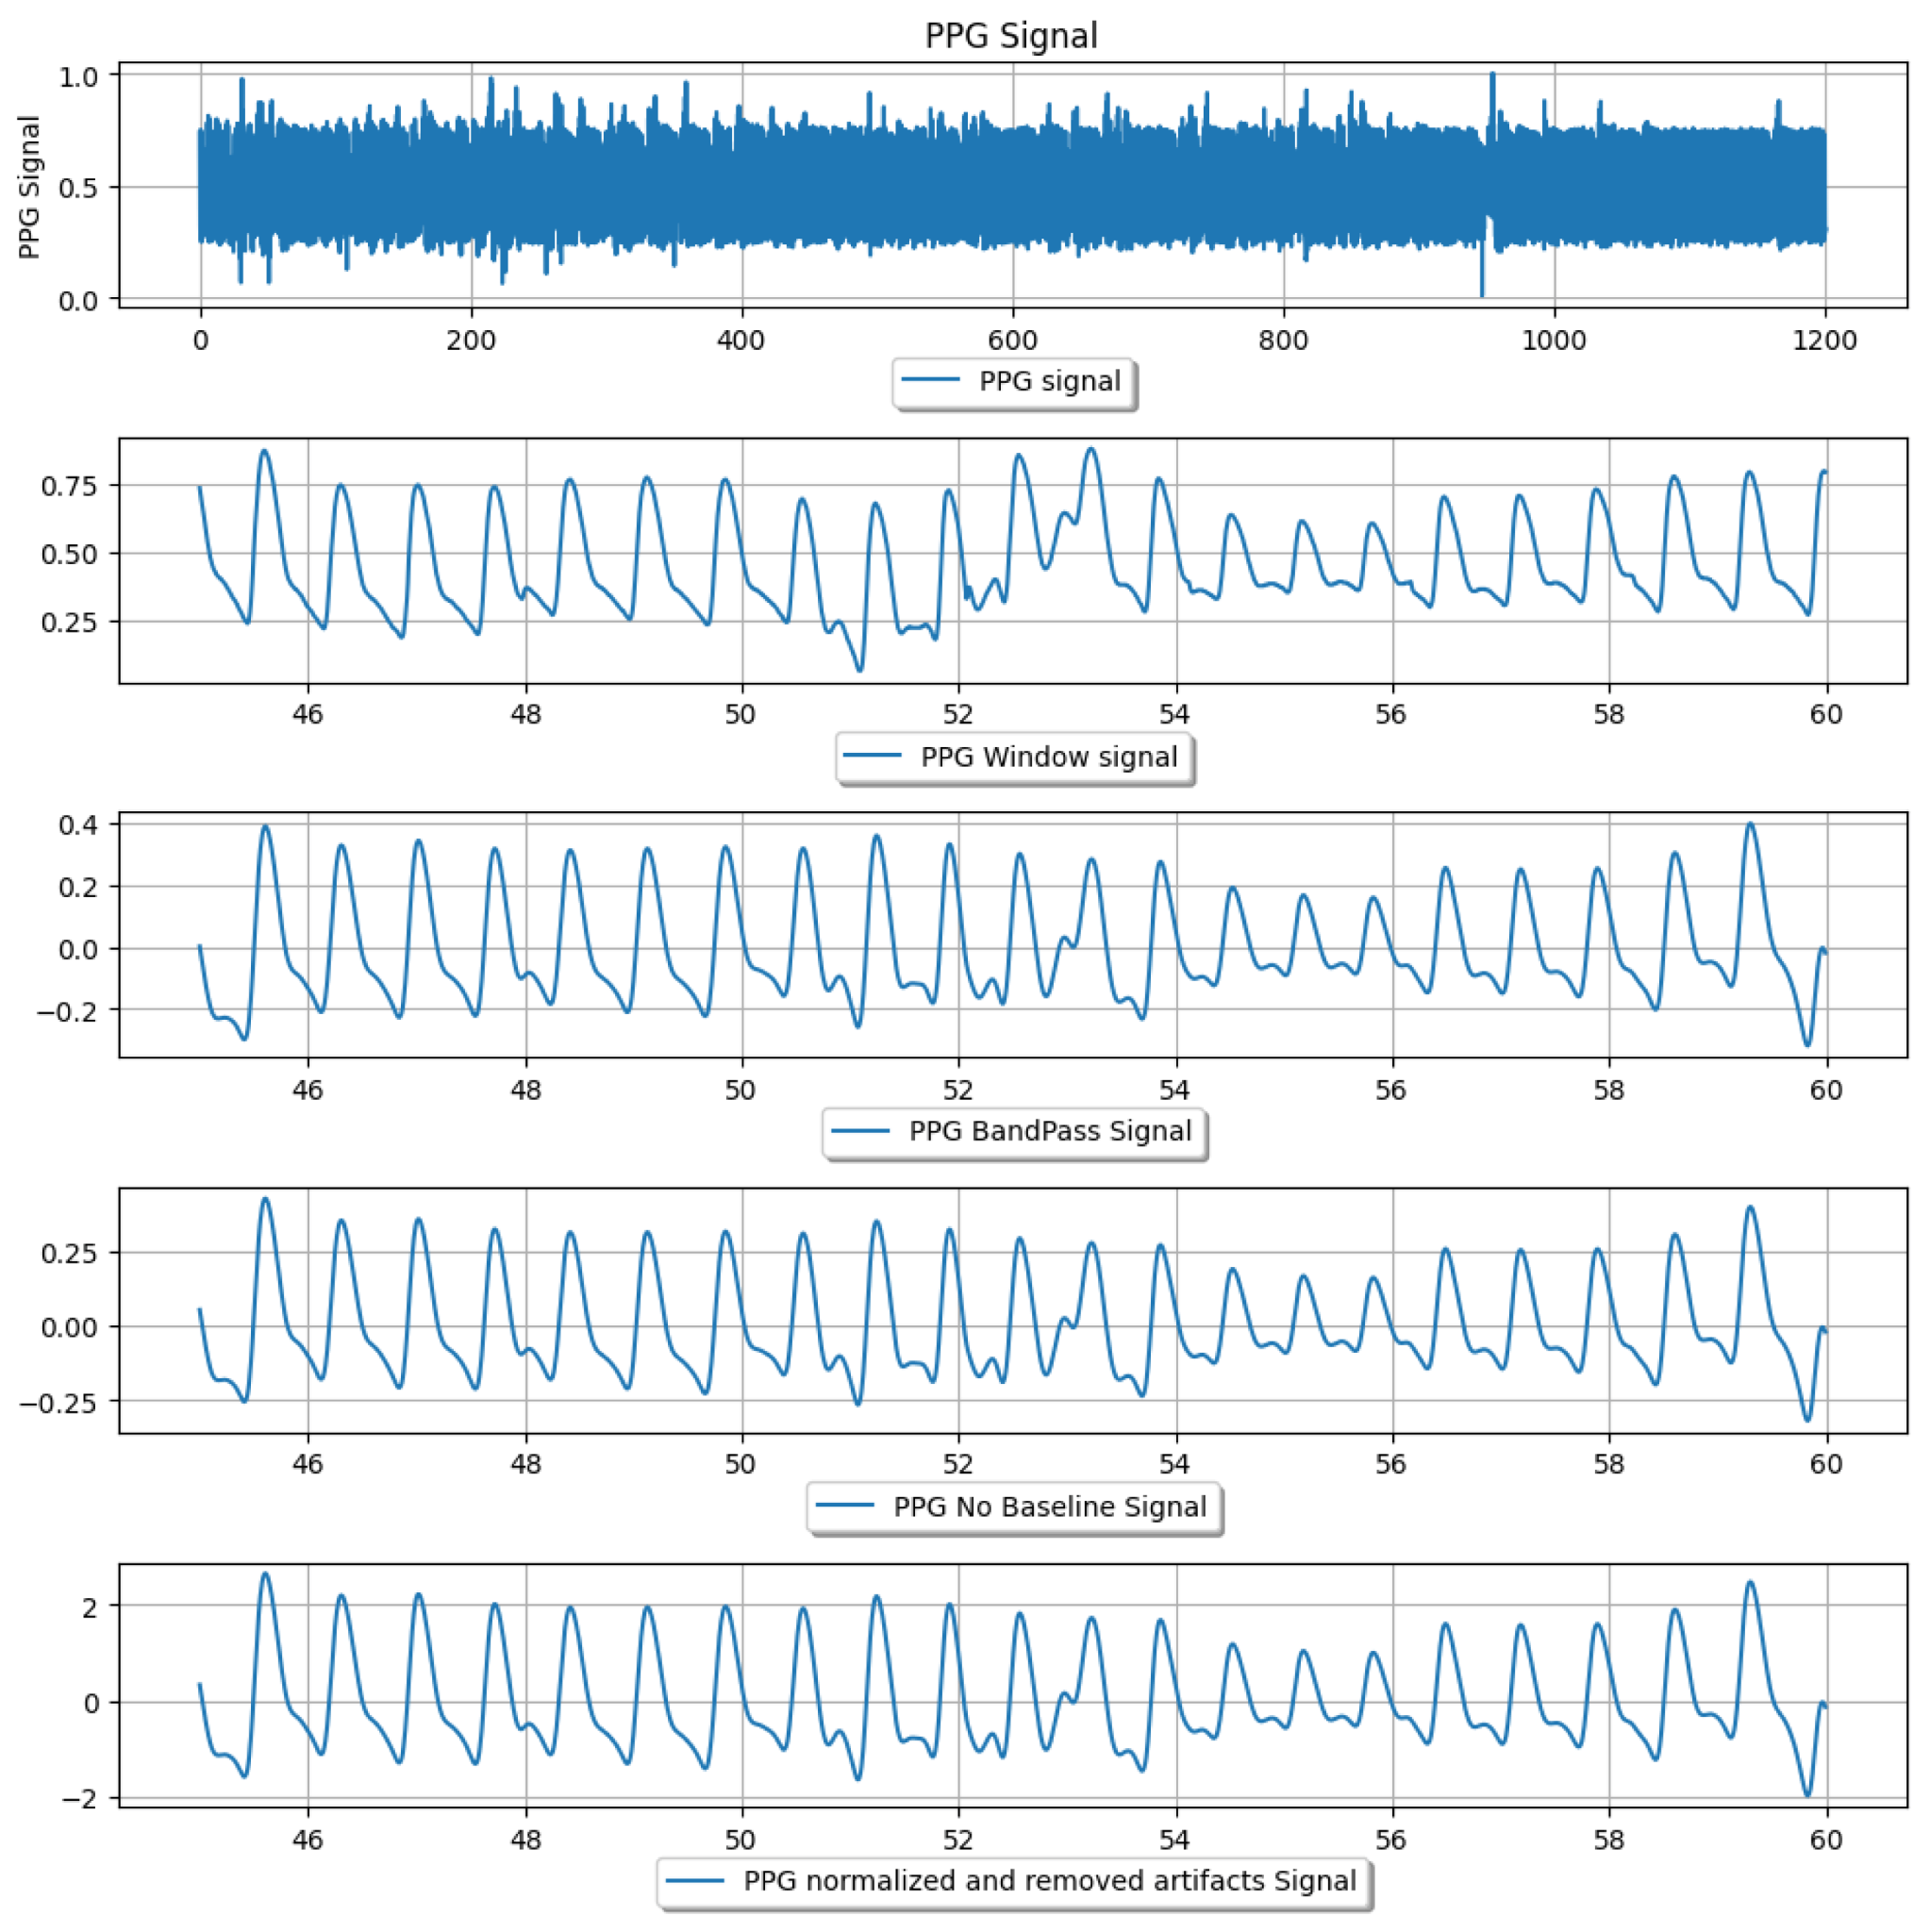
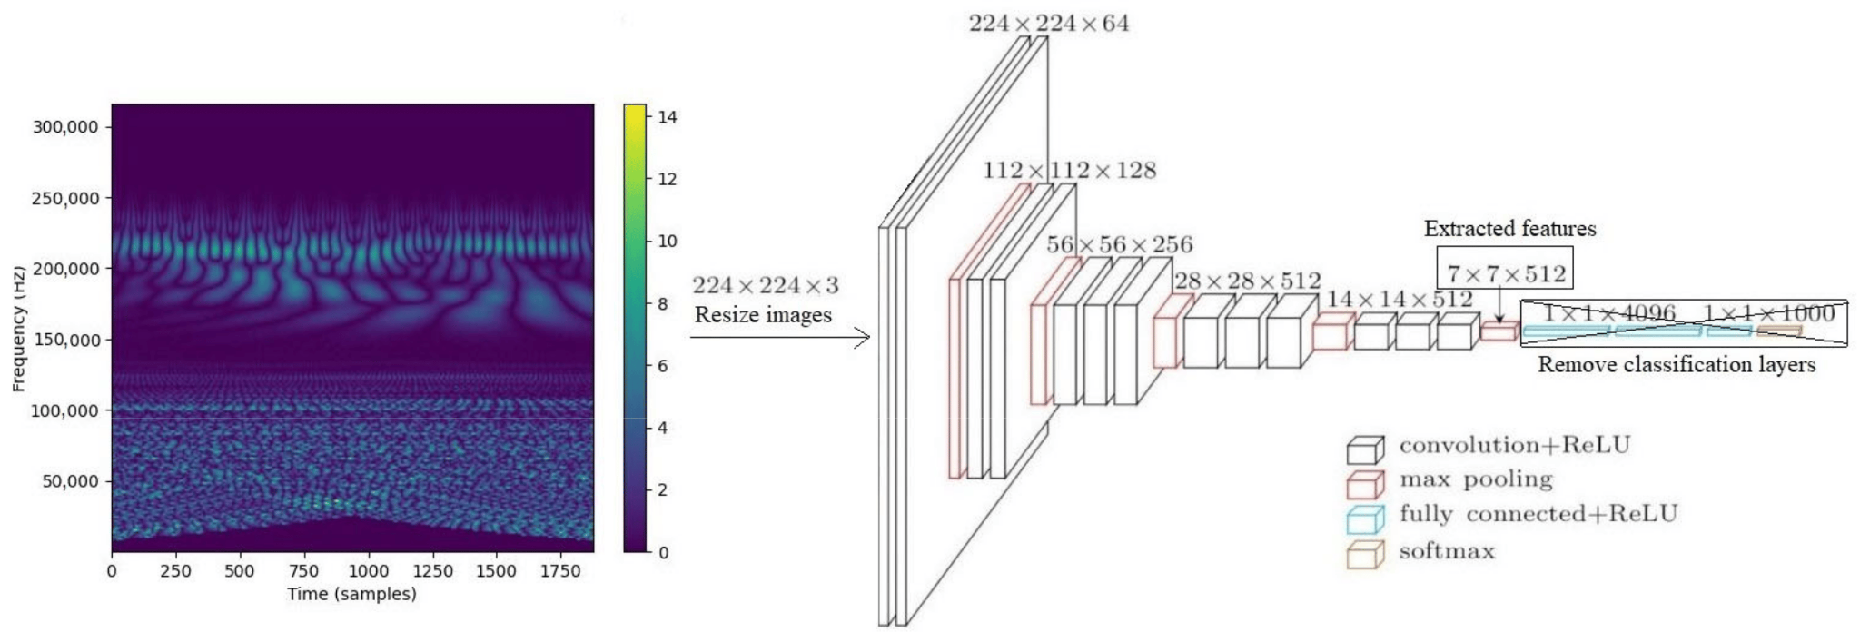
Leverage Existing Technology
ECG Waveform Outputs
Heart pulse diagrams one would receive at a doctor’s are available via modern smartwatch models
Wavelet Spectrograms
Images created by PPG data that can be transformed and analyzed

Slide 15
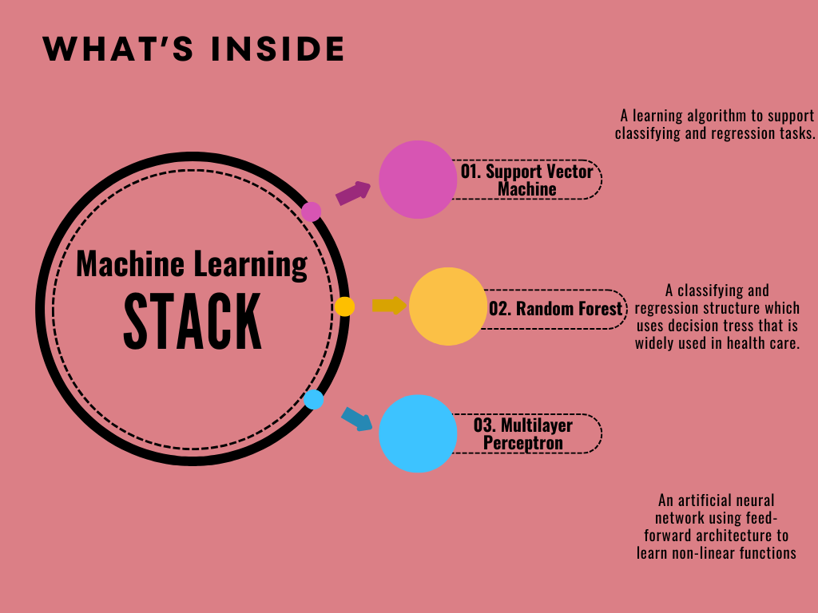
Synthesizing Data and Providing Personalized Feedback

Slide 16
MODEL ACCURACY
SVM
RF
MP
When applied to PPG sensor data, these stacked models achieve an accuracy score of .9768 and an AUC score of .99

Slide 17
Benefits of HeartWatch
Improved Health Outcomes and Risk Reduction
Enables proactive management of AFib symptoms and risk factors Helps users make informed decisions about their health and lifestyle choices
Reduces the risk of serious complications and improves overall health outcomes.
Continuous Monitoring Support
Provides real-time monitoring of vital signs and symptoms
Alerts users to abnormal vitals or symptoms that require medical attention
Offers peace of mind and reassurance through continuous support
Addressing Adherence Issues
Reminds users to take medication on time and in the correct dosage Tracks medication intake patterns to ensure adherence to treatment plans Reduces the risk of missed doses and improper medication management

Slide 18
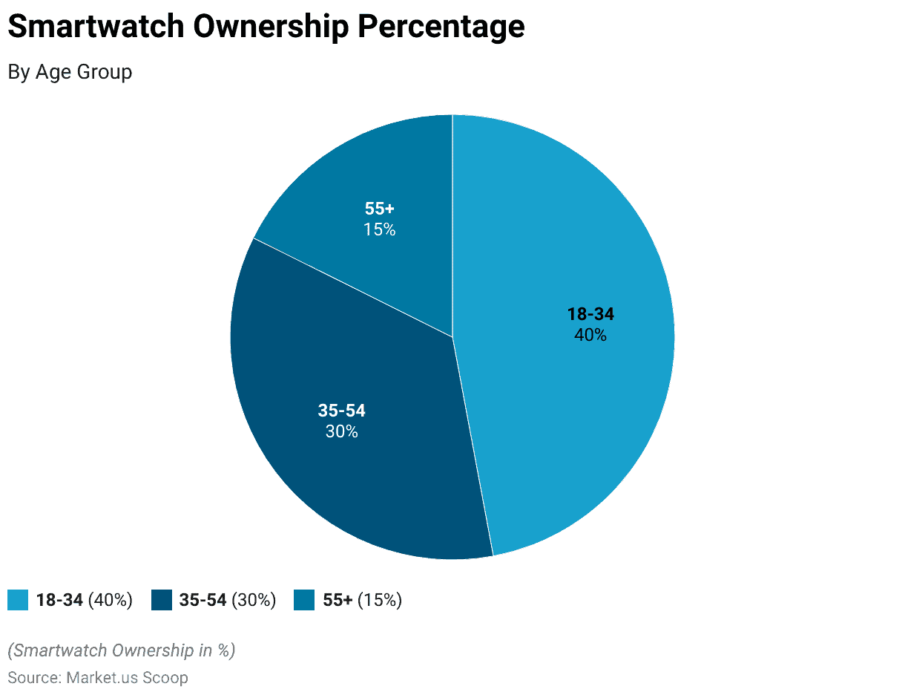
Target Demographic
Users aged 55 and above are increasingly interested in smartwatches with medical monitoring capabilities, such as heart rate and blood pressure tracking.
Medical Apps provide a market opportunity of $110 Billion sollars between 2022-2032.

Slide 19
3
Competitors
PREV
NEXT

Slide 20
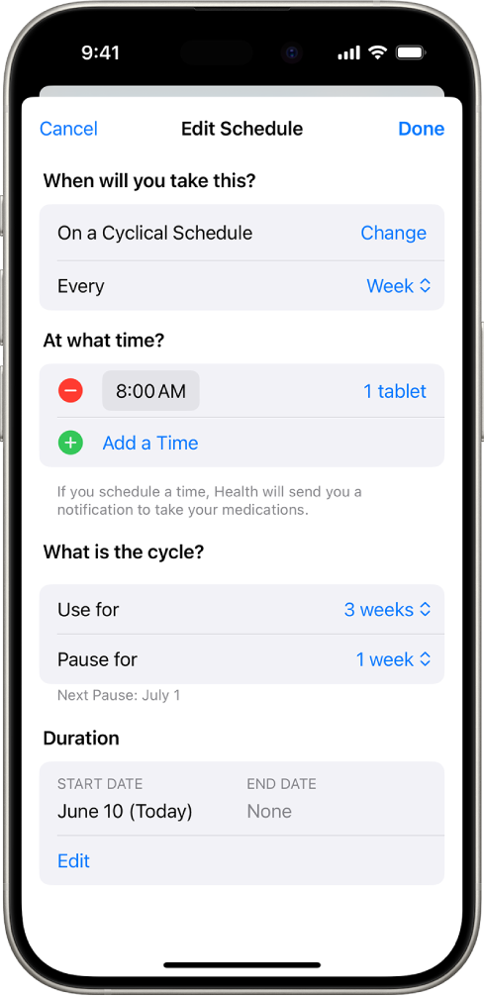
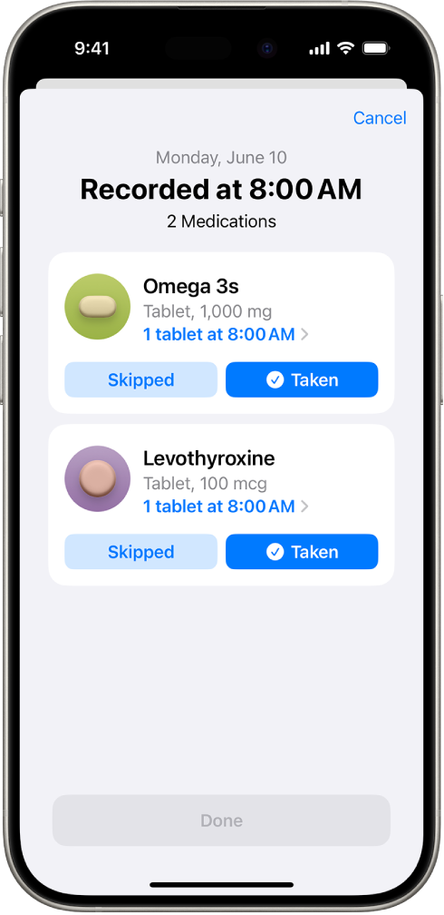
Apple Medication
PREV
NEXT
Features
Custom schedule
Share with caregivers
Drug Interactions
Drawbacks
Only on IOS
No symptom tracking
No vitals tracking

Slide 21
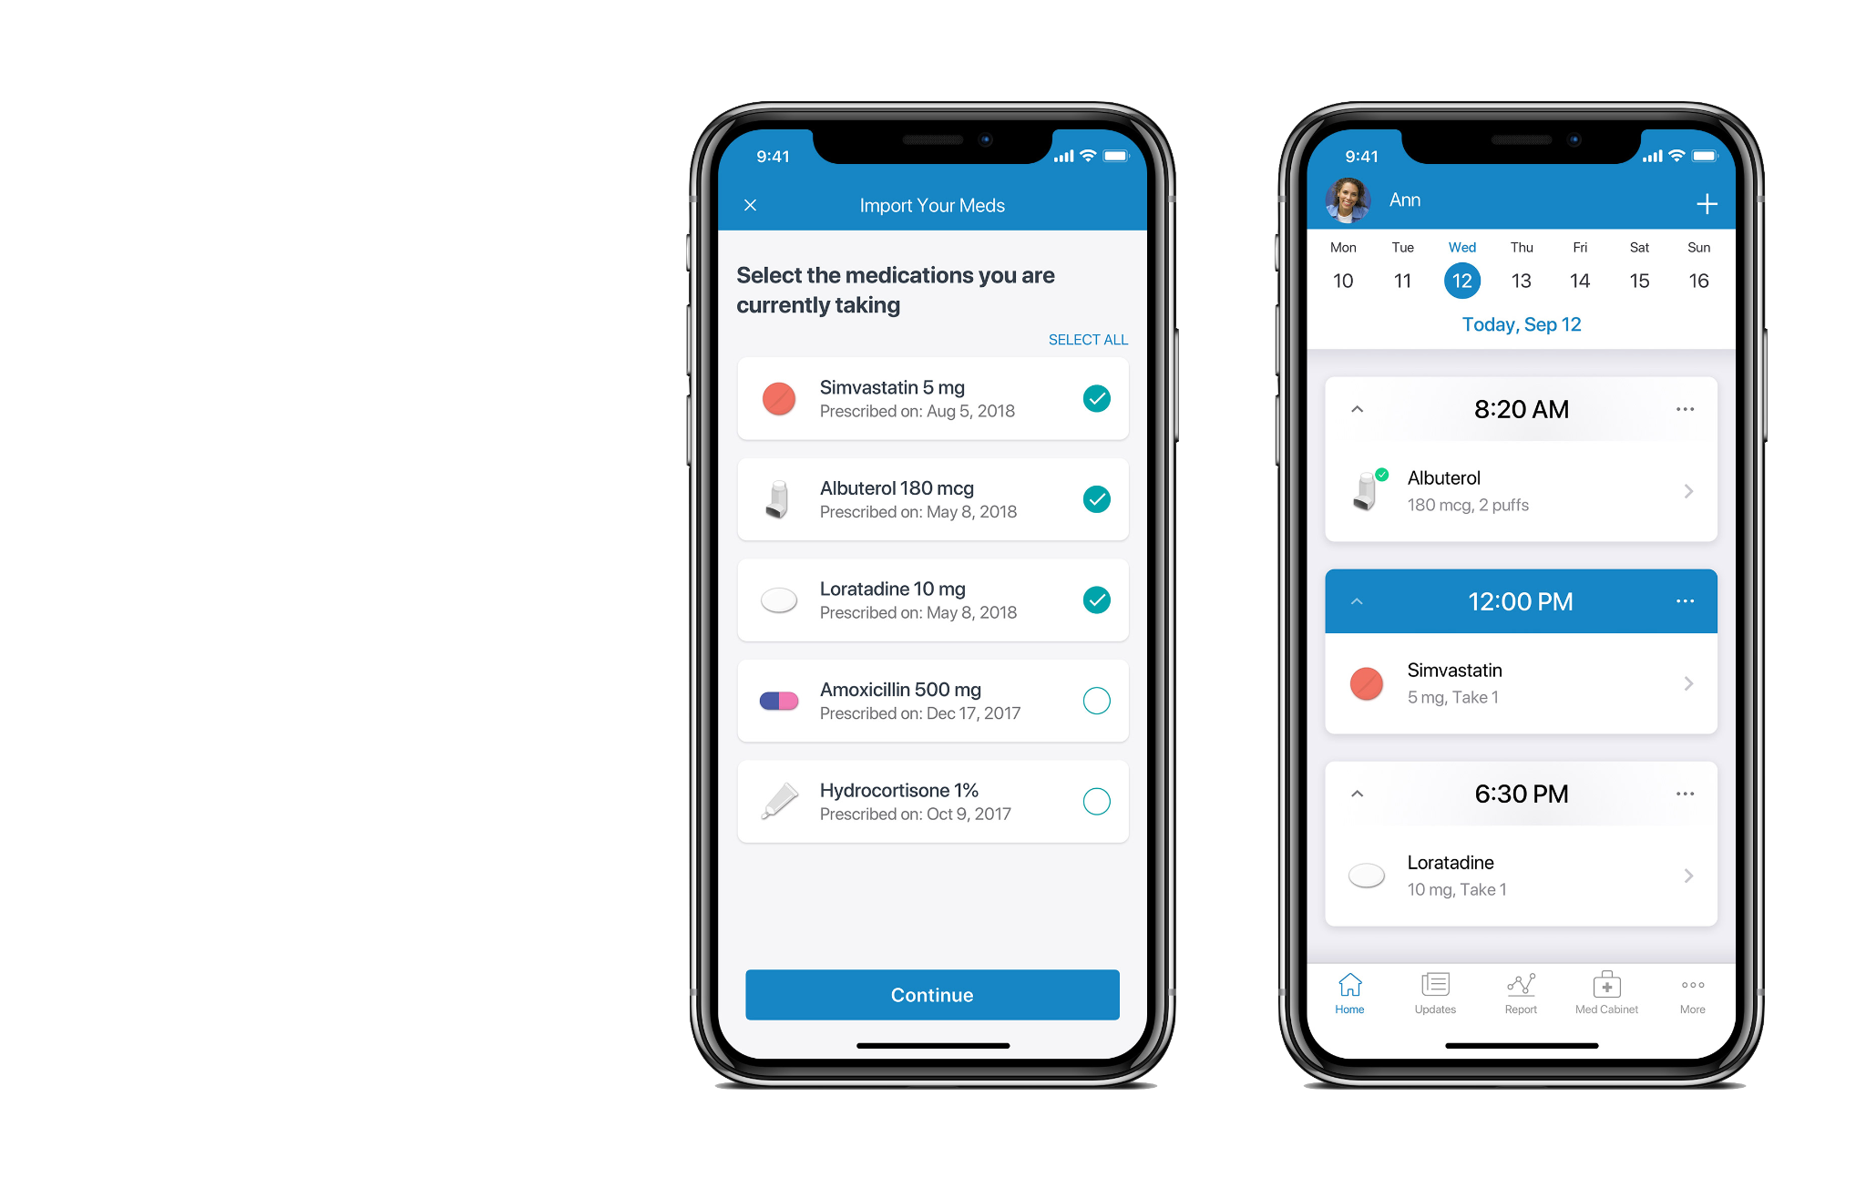
Medisafe App
PREV
NEXT
Features
Custom schedule
Share with caregivers
Drug Interactions
Symptom tracking
Available on both IOS and Android
Drawbacks
No vitals tracking

Slide 22
4
Timeline and Costs
PREV
NEXT

Slide 23
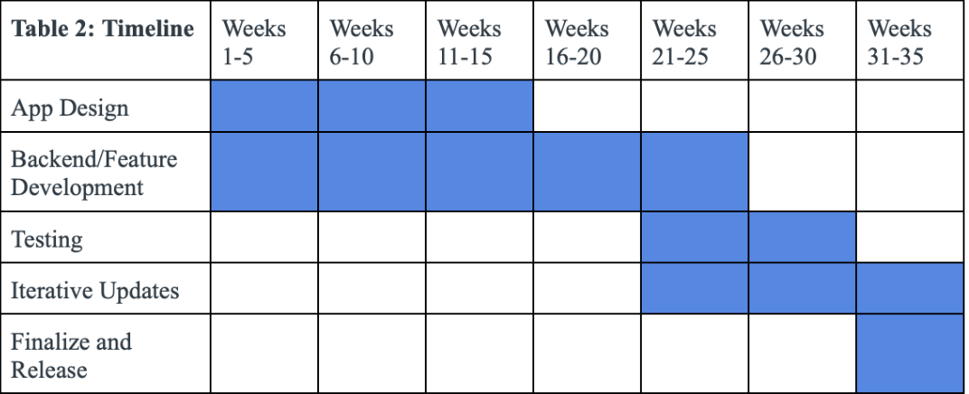
Timeline
PREV
NEXT
35 Weeks to develop app
25 weeks for feature development
15 weeks for testing

Slide 24
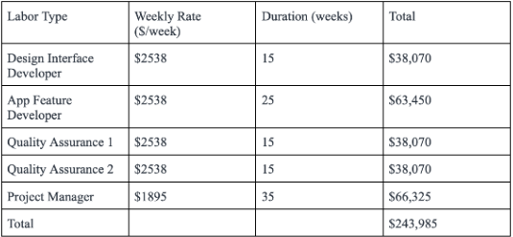
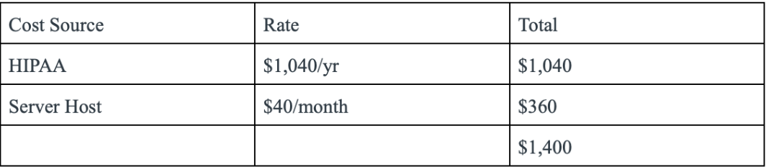
Costs
PREV
NEXT
Total Cost - $245,385
Labor
HIPAA certification
Server Hosting

Slide 25
5
Risk Management
PREV
NEXT

Slide 26
Risk Management
Incorrect Usage: Elderly users face challenges due to unfamiliarity and low self-efficacy, leading to incorrect usage
Missed Notifications: Age-related memory issues and notification fatigue may cause users to forget or ignore reminders, reducing effectiveness
Overdependence: Users may rely too heavily on devices, delaying necessary medical interventions if alerts are absent
Data Security Concerns: Elderly users often lack awareness of privacy threats, using weak passwords and sharing devices, highlighting the need for education on data security

Slide 27
6
Conclusion
PREV
NEXT

Slide 28
Conclusion
Purpose: Supports elderly AFib patients through comprehensive health monitoring and medication management.
Unique Features:
Real-time vital sign tracking.
Timely alerts for health risks.
Impact:
Empowers users to manage health proactively.
Reduces caregiver stress.
Eases burden on healthcare systems.

Slide 29
References
[1]Brian, “What You Don’t Know About Your Meds Can Kill You | Medisafe,” Medisafe, Oct. 10, 2018. https://www.medisafe.com/what-you-dont-know-about-your-meds-can-kill-you/ (accessed Nov. 06, 2024).
‌[2]“Track your medications in Health on iPhone,” Apple Support, 2024. https://support.apple.com/guide/iphone/track-your-medications-iph811670c81/ios (accessed Nov. 06, 2024).
[3] B. P. Krijthe, A. Kunst, E. J. Benjamin, G. Y. H. Lip, O. H. Franco, A. Hofman, J. C. M. Witteman, B. H. Stricker, and J. Heeringa, "Projections on the number of individuals with atrial fibrillation in the European Union, from 2000 to 2060," Eur. Heart J., vol. 34, pp. 2746-2751, 2013.
[4] E. J. Benjamin, P. A. Wolf, R. B. D’Agostino, H. Silbershatz, W. B. Kannel, and D. Levy, "Impact of Atrial Fibrillation on the Risk of Death," Circulation, vol. 98, no. 10, pp. 946-952, Sep. 1998.
[5] S. J. Czaja et al., "Factors Predicting the Use of Technology: Findings from the Center for Research and Education on Aging and Technology Enhancement (CREATE)," Psychology and Aging, vol. 21, no. 2, pp. 333–352, 2006.
[6] K.-J. Brickwood, A. D. Williams, G. Watson, and J. O’Brien, "Older adults' experiences of using a wearable activity tracker with health professional feedback over a 12-month randomized controlled trial," Digital Health, vol. 6, pp. 1-13, 2020.
[7] P. A. Williams and V. McCauley, "Always Connected: The Security Challenges of the Healthcare Internet of Things," Journal of Medical Internet Research, vol. 18, no. 6, 2016.

